Slide 1


Ad-hoc Insights Consumer Goods
Tools Used : SQL, Power BI, MS-Excel, Canva, Ray.so
Created by :
ADITYA SINGH

Slide 2
Objectives
Atliq Hardware (fictitious corporation) is one of the major computer hardware manufacturers in India, with a strong presence in other nations.
Nevertheless, the management did note that they do not have sufficient insights to make prompt, wise, and data-informed judgments.
Plan to expand the data analytics team by adding junior data analysts.
To assess candidates, Data analytics director, Tony Sharma plans to conduct a SQL challenge to evaluate both tech and soft skills.
The company seeks insights for 10 ad hoc requests.

Slide 3
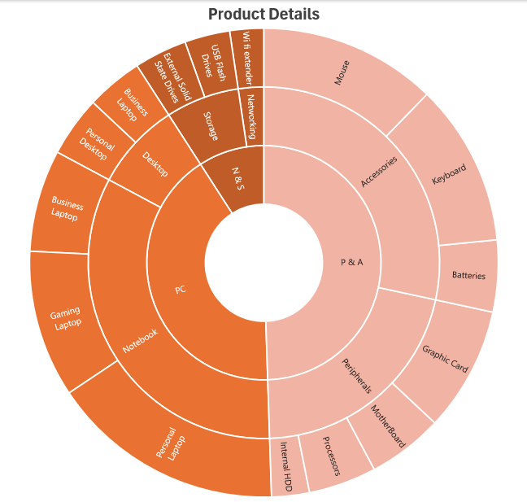
Company Details
Outer Circle :
Category
Mid Circle :
Segment
Atliq’s fiscal year : September to August
FY 2020 (Sept 19 – Aug 20)
FY 2021(Sept 20 – Aug 2021)
Inner Circle :
Division

Slide 4
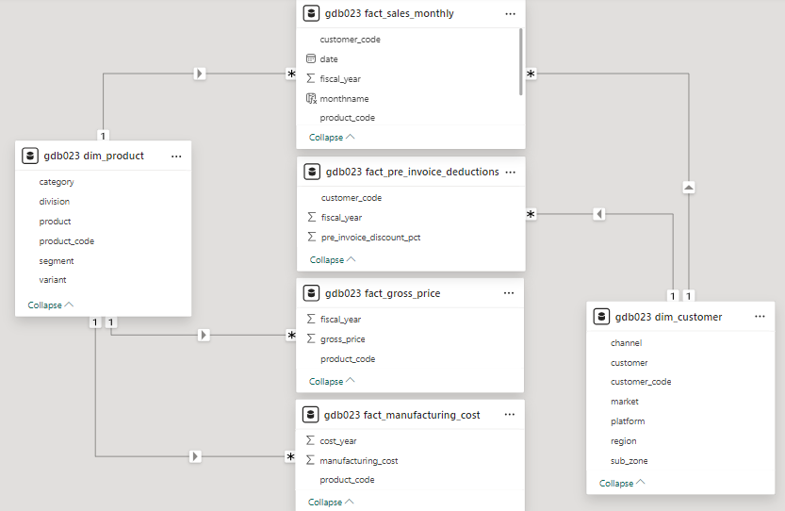
Data ( tables and relationships)

Slide 5
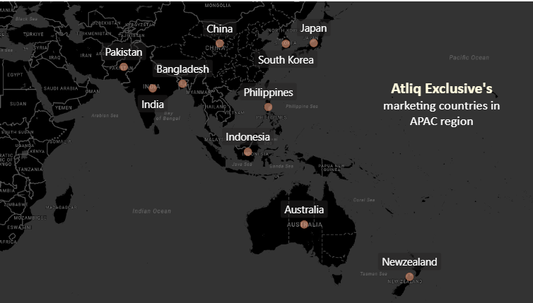
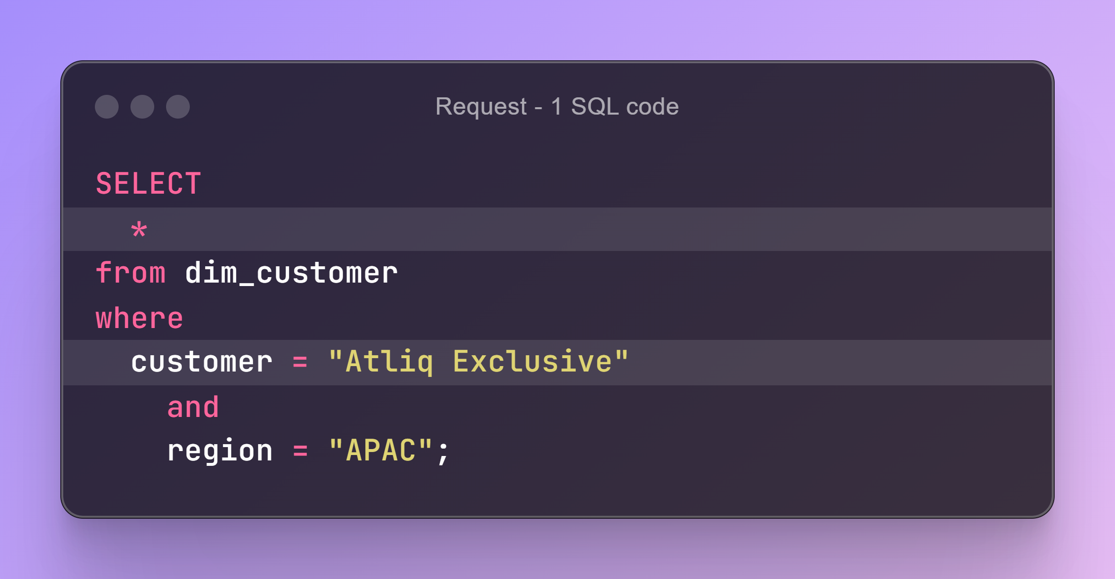
Request : 1 Provide the list of markets in which customer "Atliq Exclusive" operates its business in the APAC region.

Slide 6
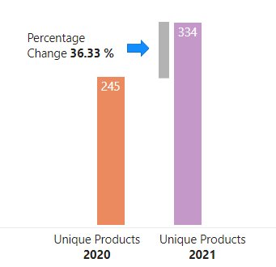
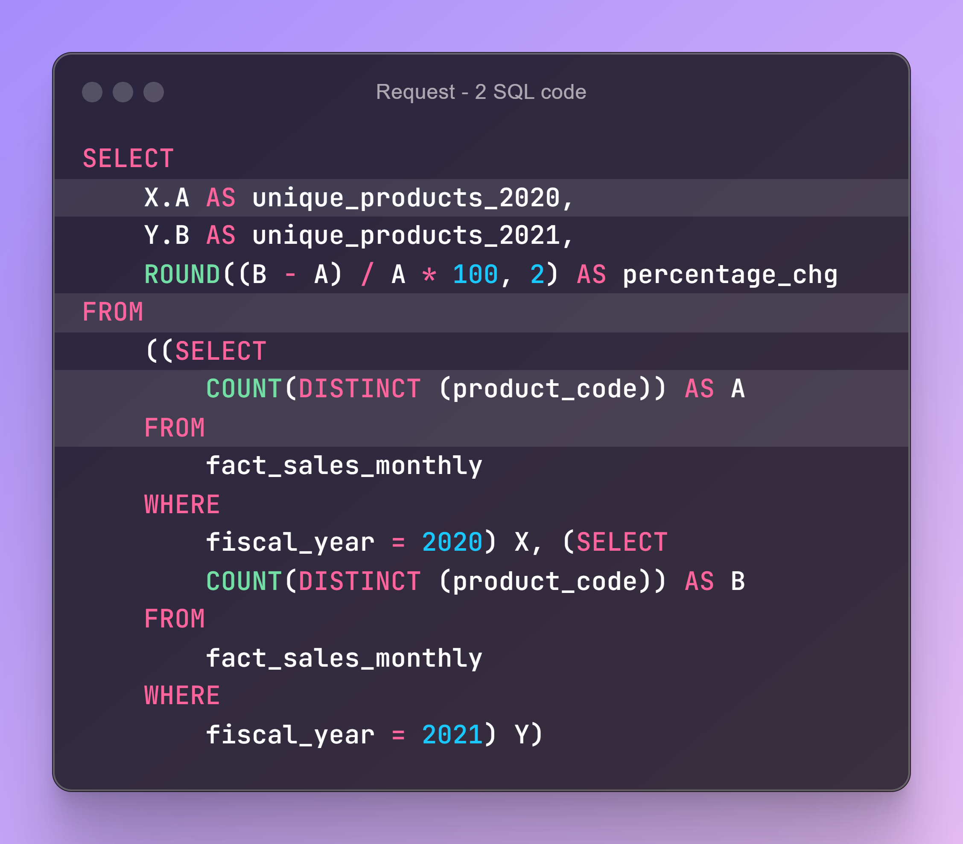
Request 2 : What is the percentage of unique product increase in 2021 vs. 2020?

Slide 7
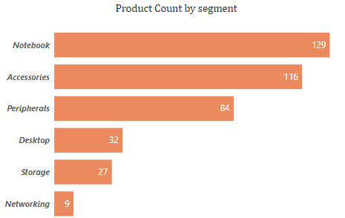
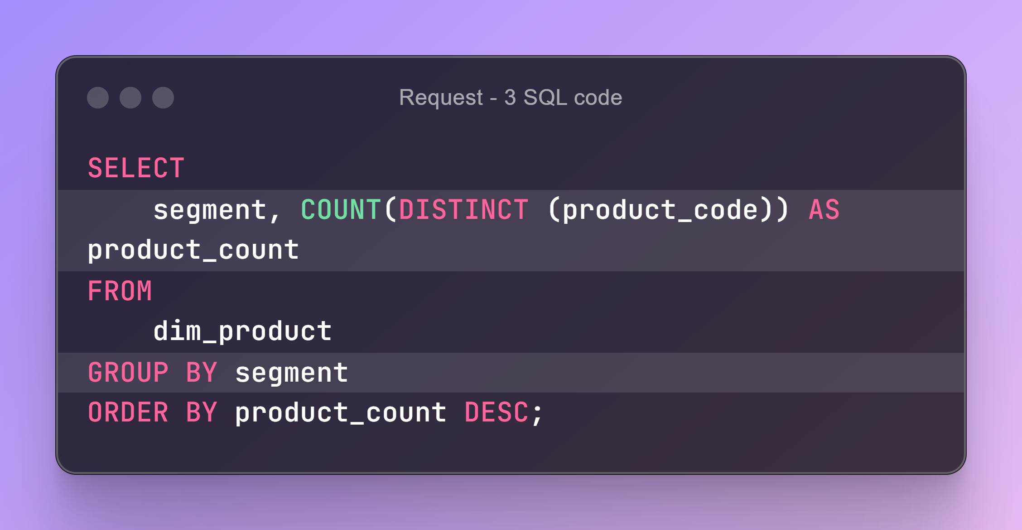
Request 3 : Provide a report with all the unique product counts for each segment and sort them in descending order of product counts.
Insights :
Notebook, Accessories and Peripherals comprise 83% of the total products

Slide 8
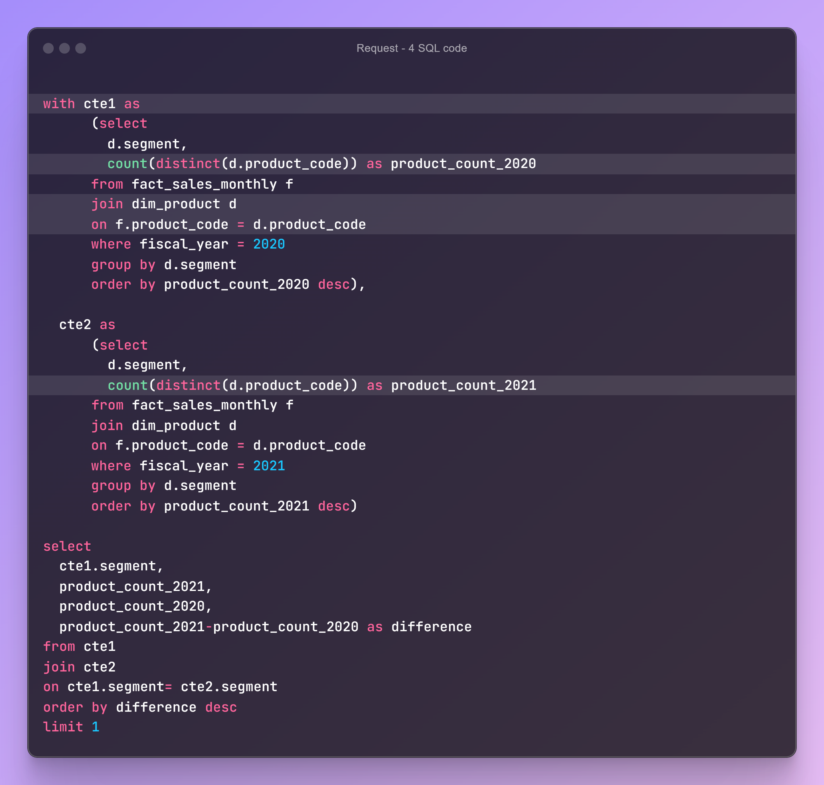
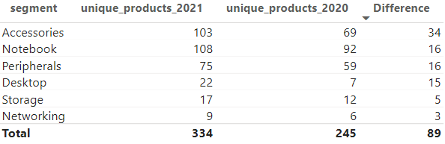
Request 4 : Follow-up: Which segment had the most increase in unique products in 2021 vs 2020?
Insights :
Storage and Desktop segments experience less unique product increase from 2020 to 2021 compared to other segments.

Slide 9
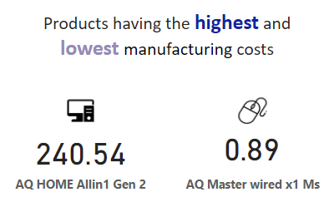
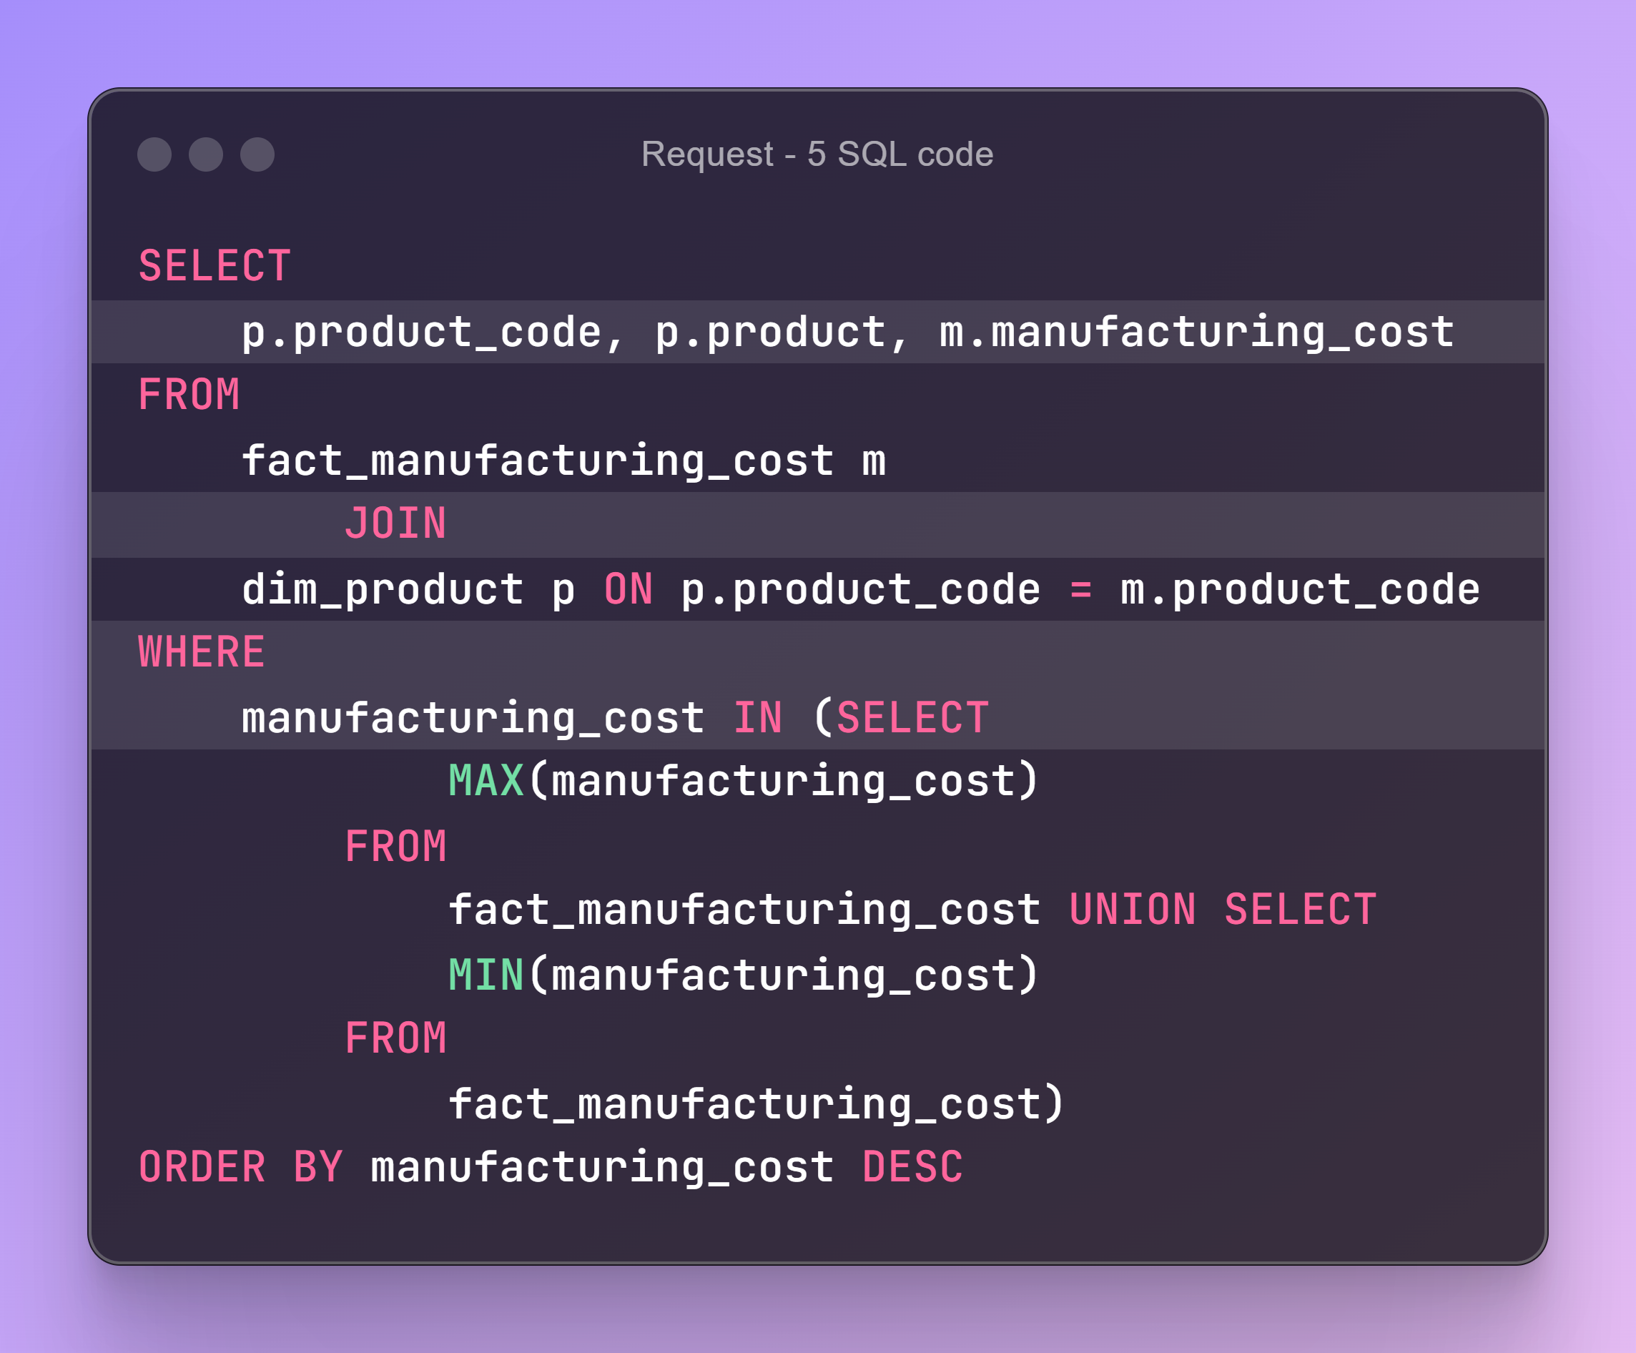
Request 5 : Get the products that have the highest and lowest manufacturing costs.

Slide 10
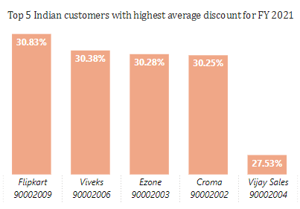
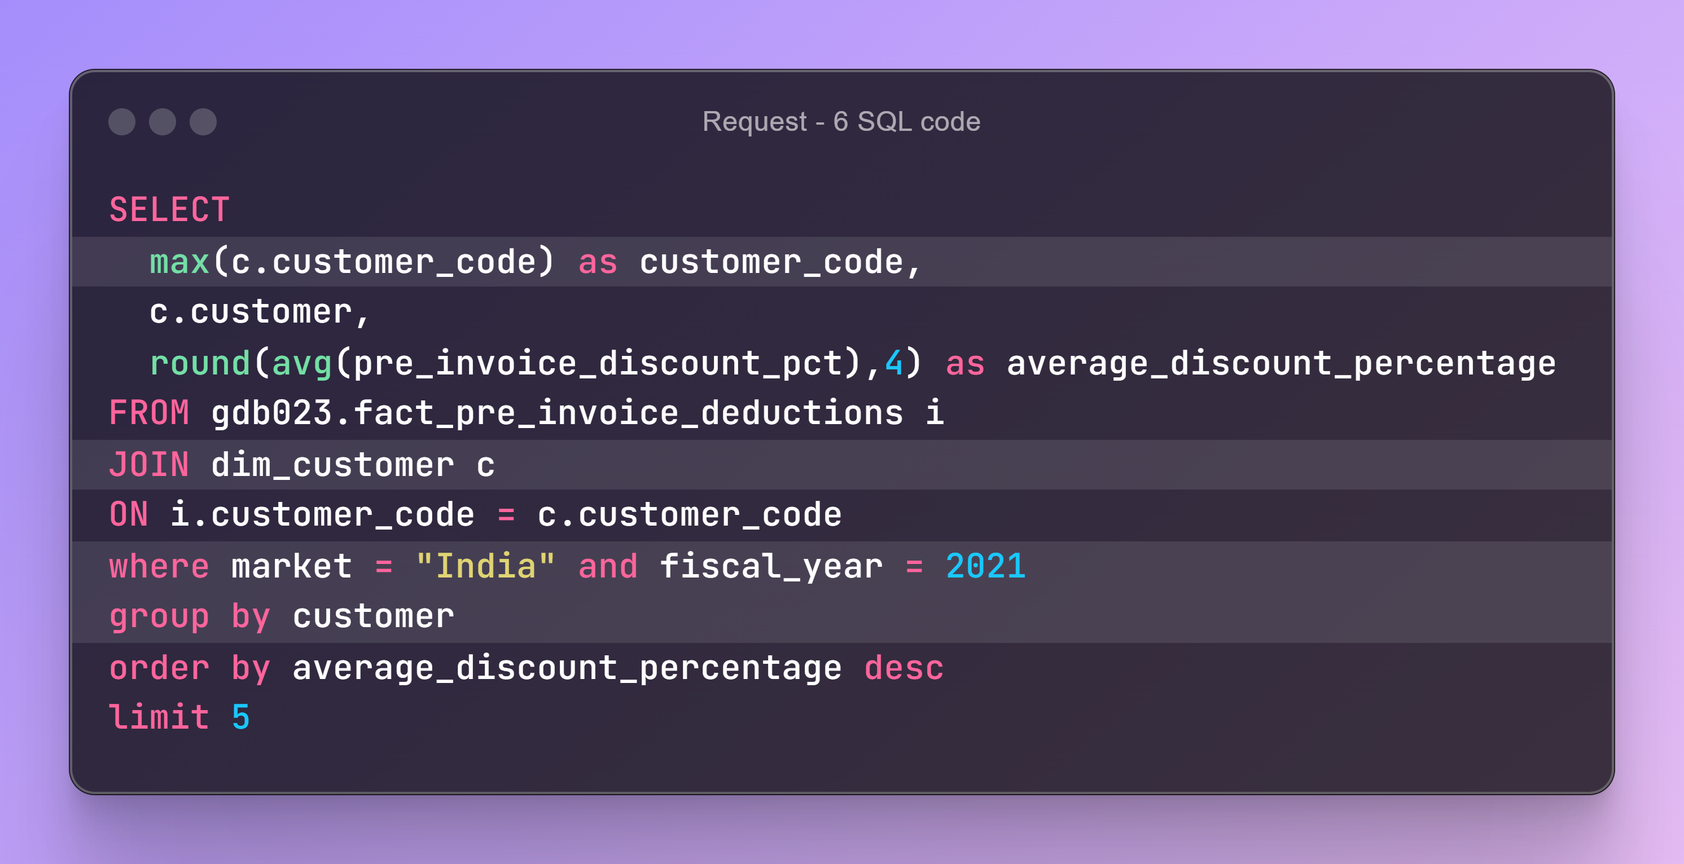
Request 6 : Generate a report which contains the top 5 customers who received an average high pre_invoice_discount_pct for the fiscal year 2021

Slide 11
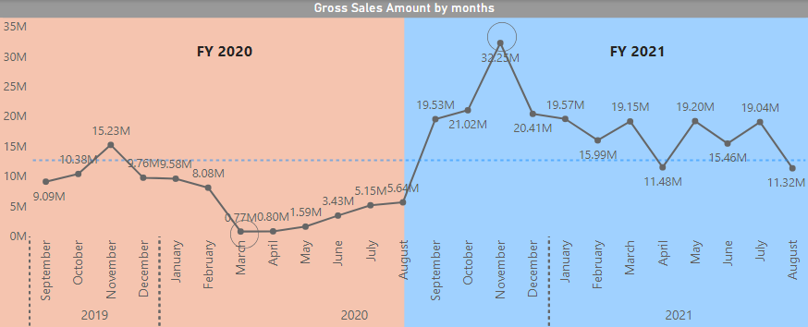
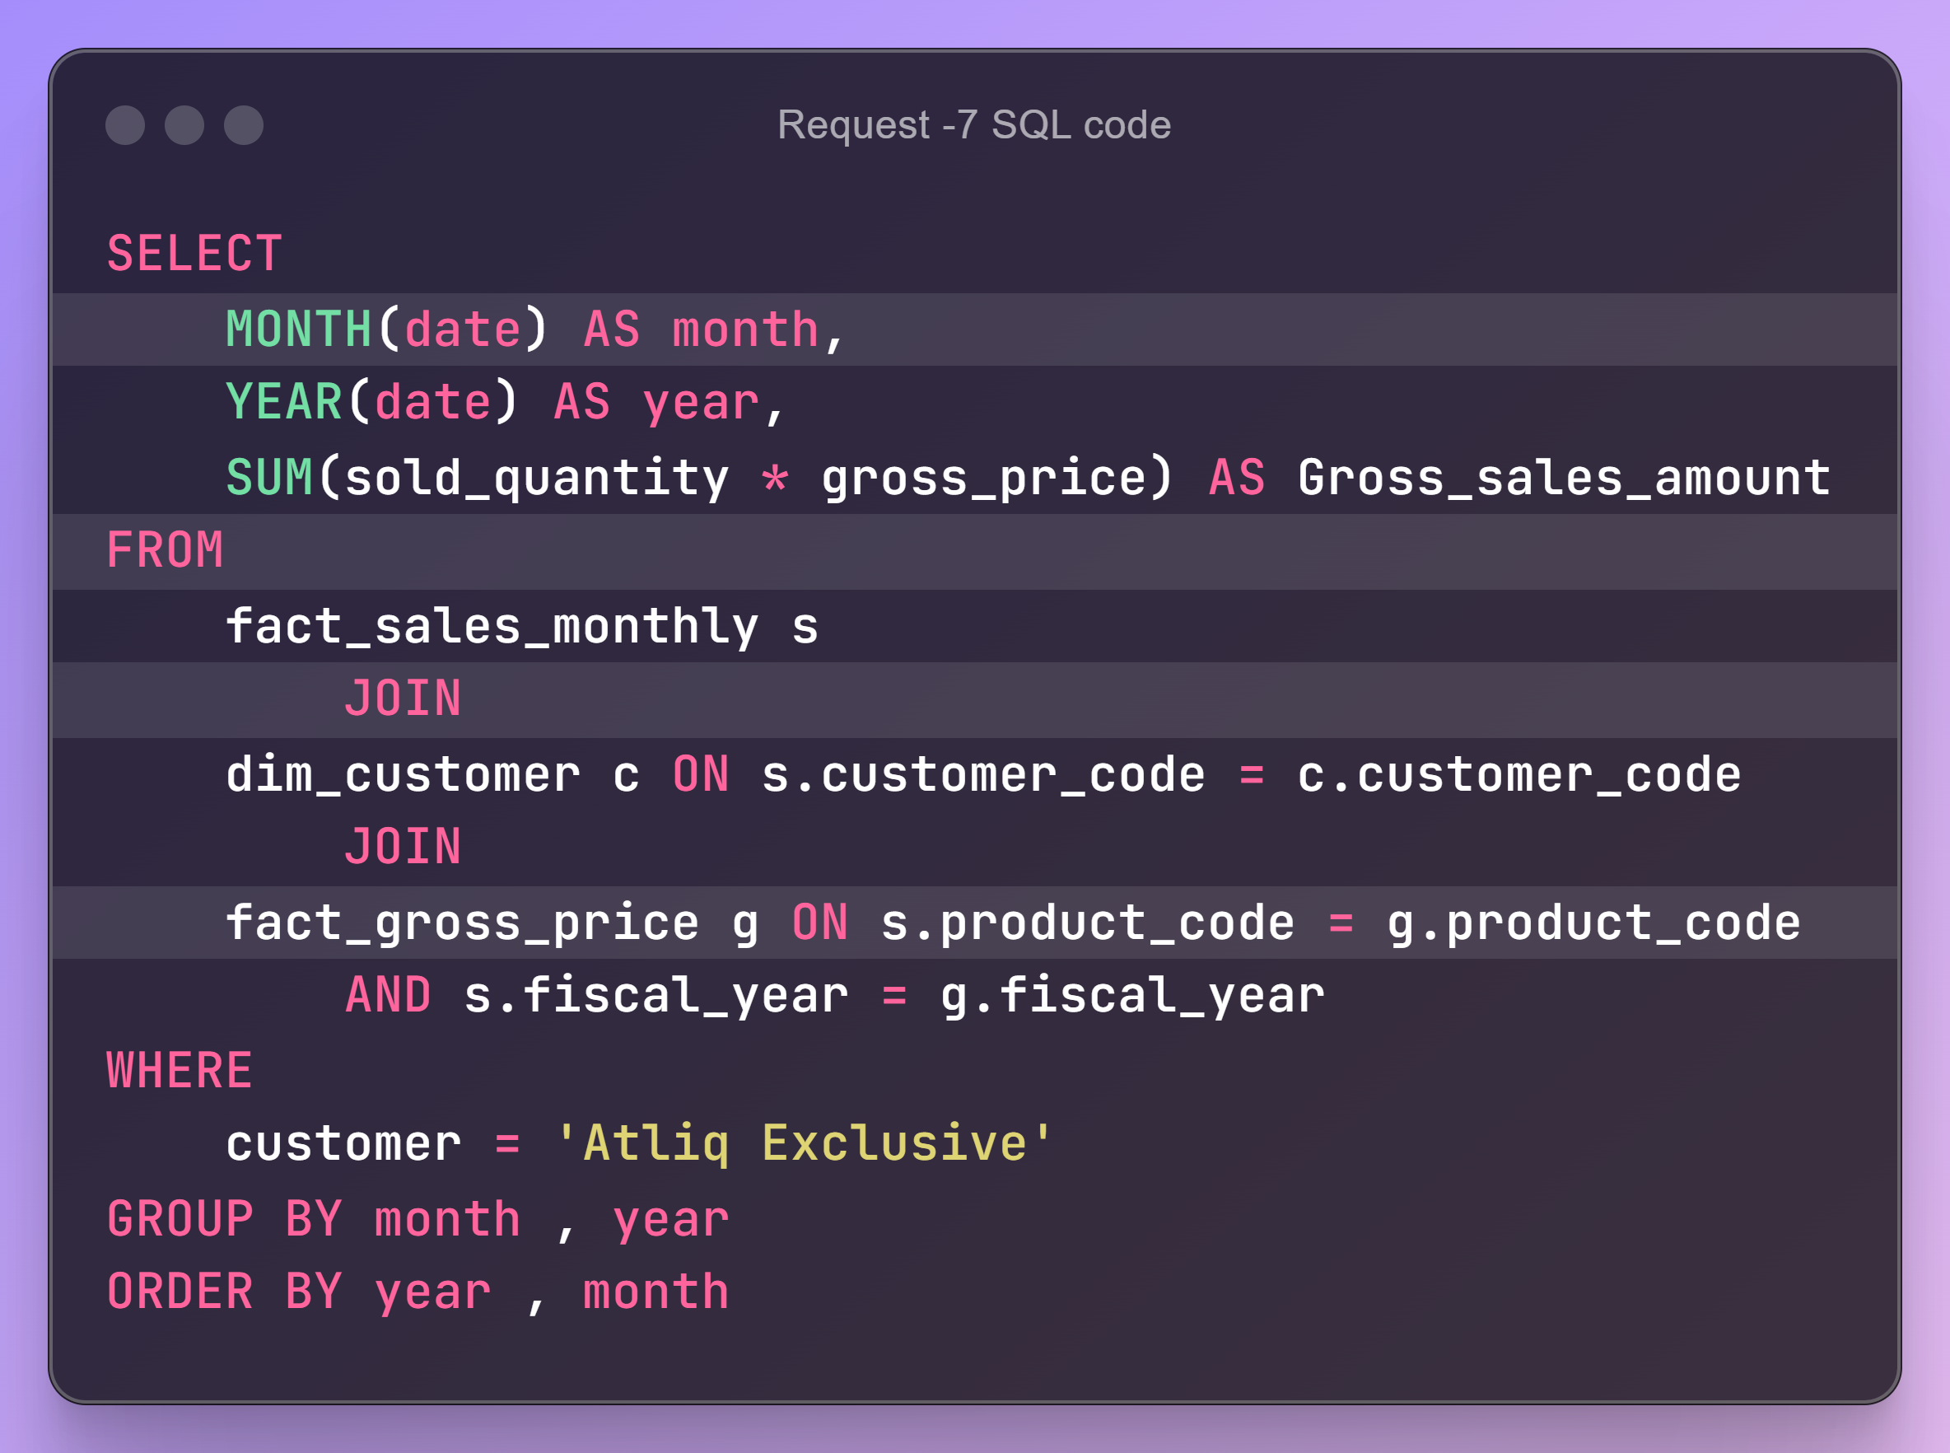
Request 7 : Get the complete report of the Gross sales amount for the customer “Atliq Exclusive” for each month.
Insights :
The lowest performing month is March 2020 i.e. 0.77 million.
The highest performing month is November 2021 i.e. 32.25 million.
Average sales amount is 13.2 million.

Slide 12
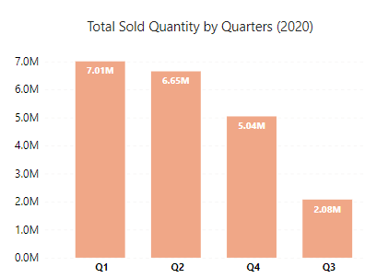
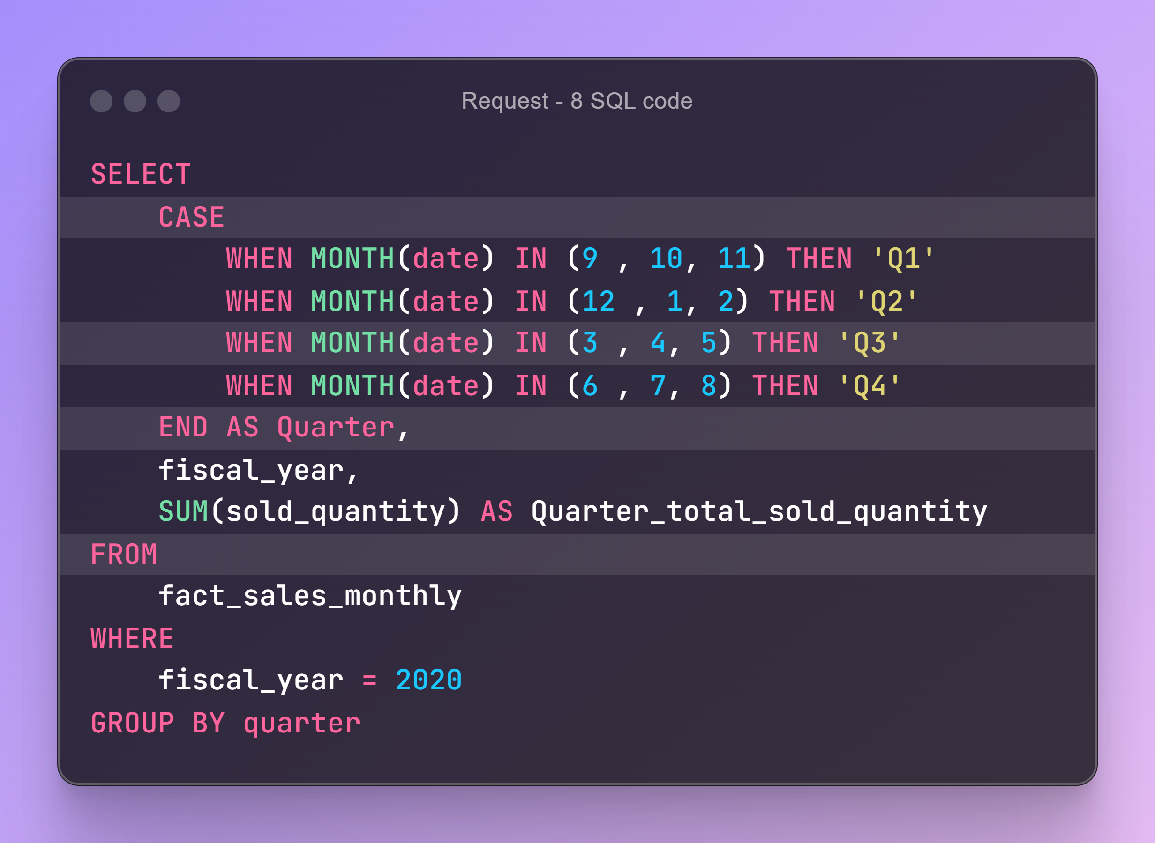
Request 8 : In which quarter of 2020, got the maximum total_sold_quantity?

Slide 13
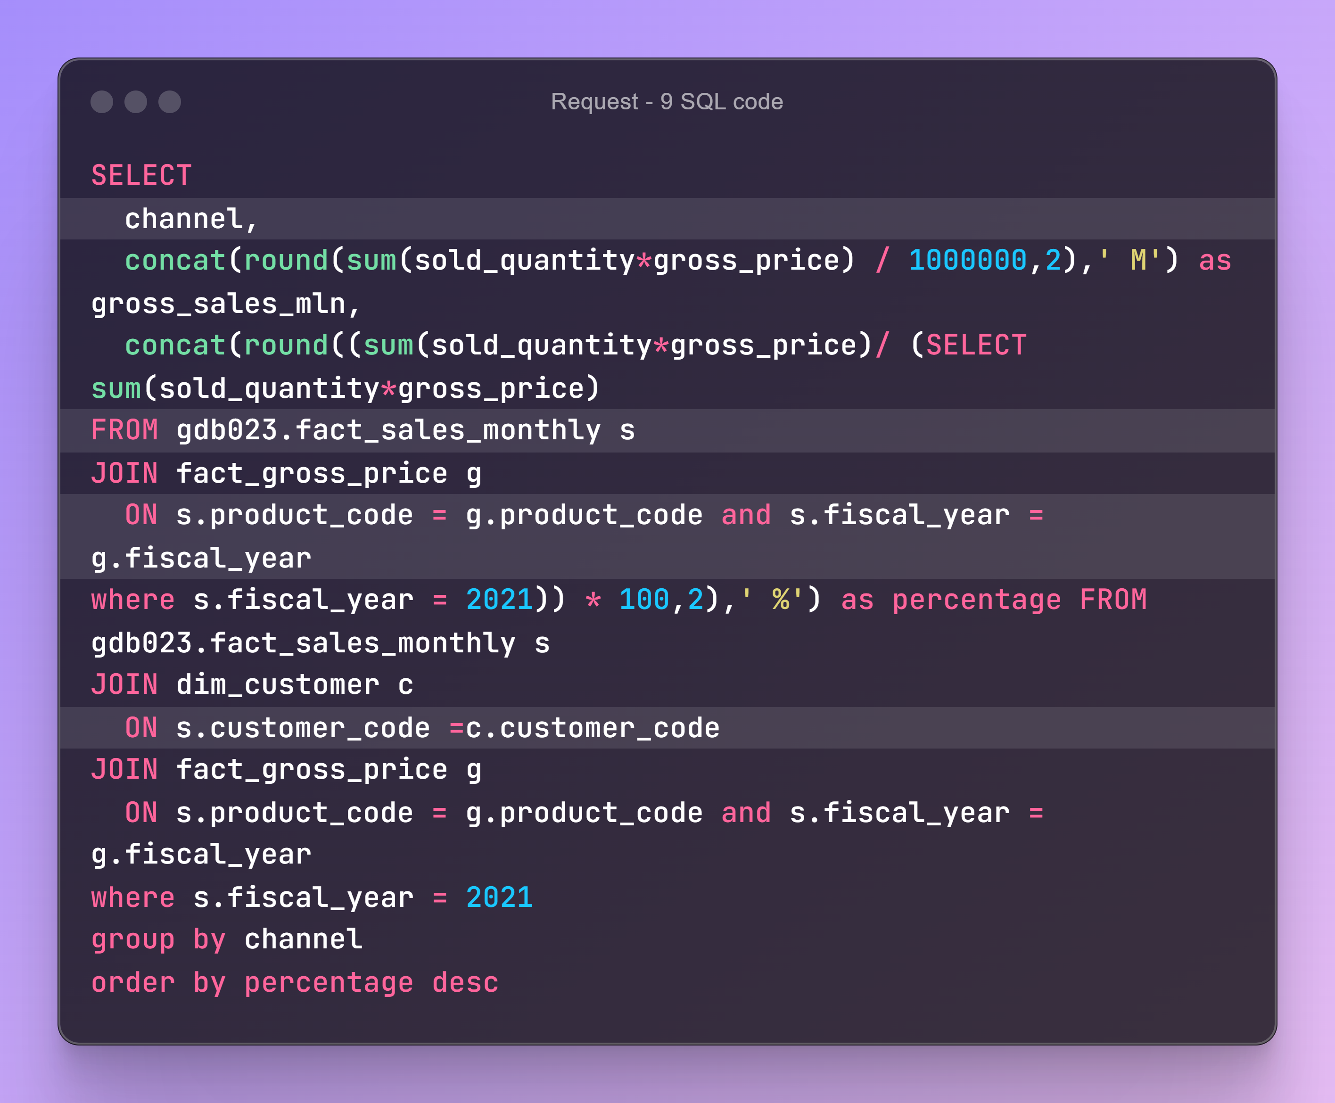
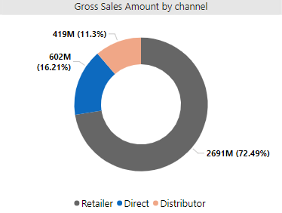
Request 9 : Which channel helped to bring more gross sales in the fiscal year 2021 and the percentage of contribution?

Slide 14
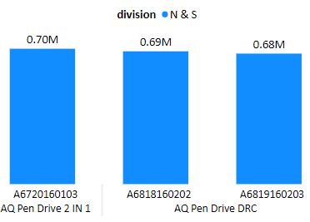
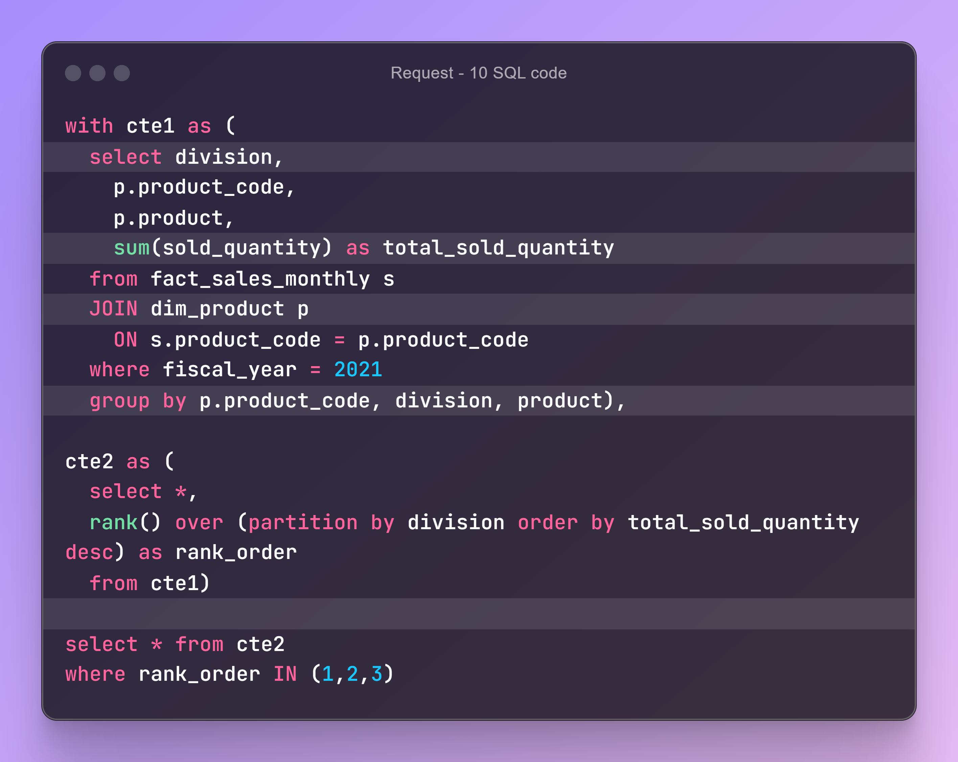
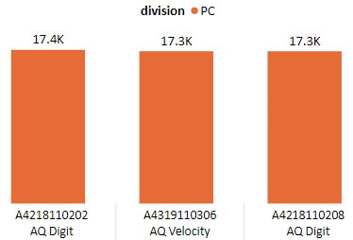
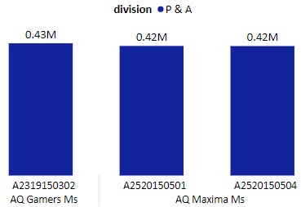
Request 10 : Get the Top 3 products in each division that have a high total_sold_quantity in the fiscal_year 2021?
Insights :
Every division has a product with different variants that appears twice in the top three products by divisions list.

